Slide 1
Enhancing programming solutions through the integration of LLM API’s
By Patrick Carnevale

Slide 2
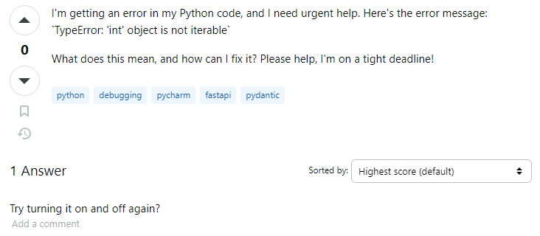
Introduction:
Whether you’re a new or veteran coder, Stack Overflow is a valuable resource for learning to code, however, there are some challenges and potential issues that learners may encounter, including:
Complexity of Responses
Lack of Explanation
Outdated Information
Differing Skill Levels
Limited Context
Over-Reliance on Copy-Pasting
Ineffective Communication
Subjectivity or Bias

Slide 3
Research Objective:
Our goal is to improve Stack Overflow answers using Large Language Models (LLMs) such as ChatGPT, to enhance user experience and code quality.
How? (steps)
By making a program that will take programming questions + answers from Stack Overflow
Run them through a (LLM) (API) to generate an answer.
Then combine that answer with the original question/answer in a now trained (LLM) (API)
To produce an improved answer that is more accurate, descriptive and straightforward.
Programming language of choice:
Python

Slide 4
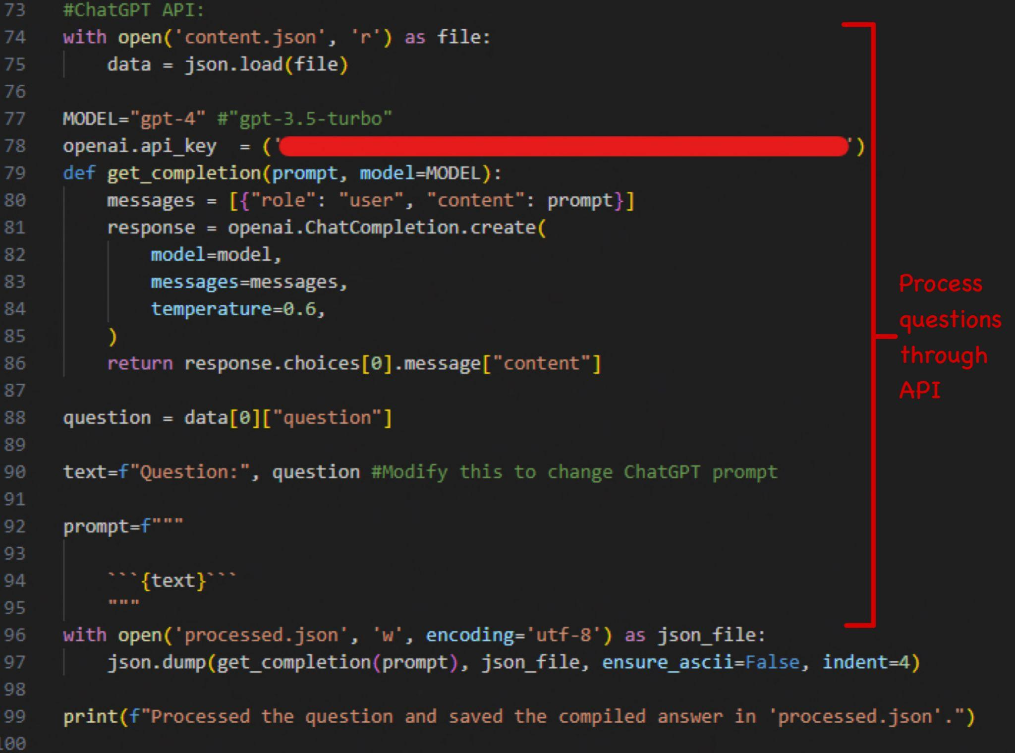
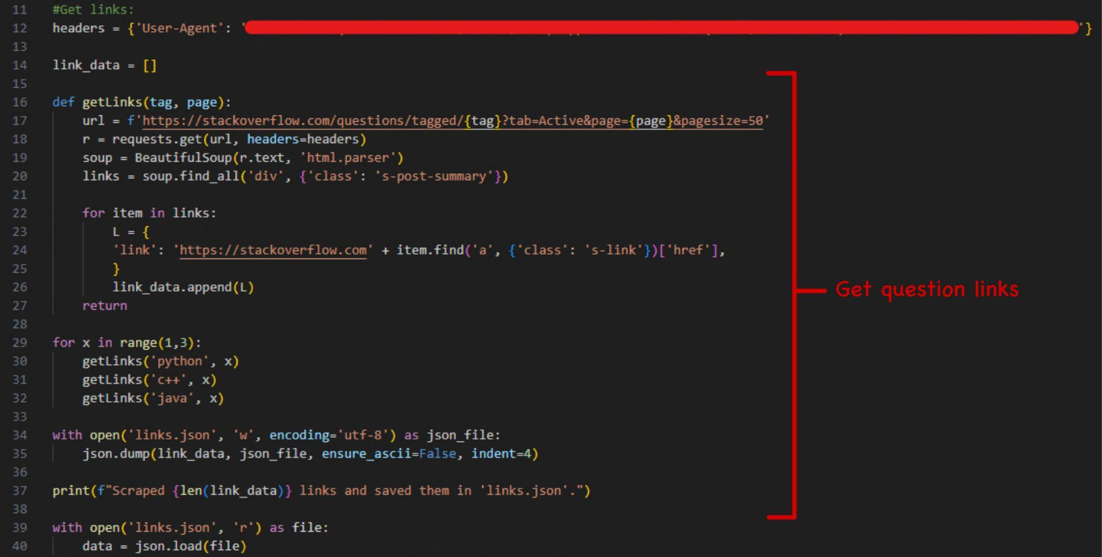
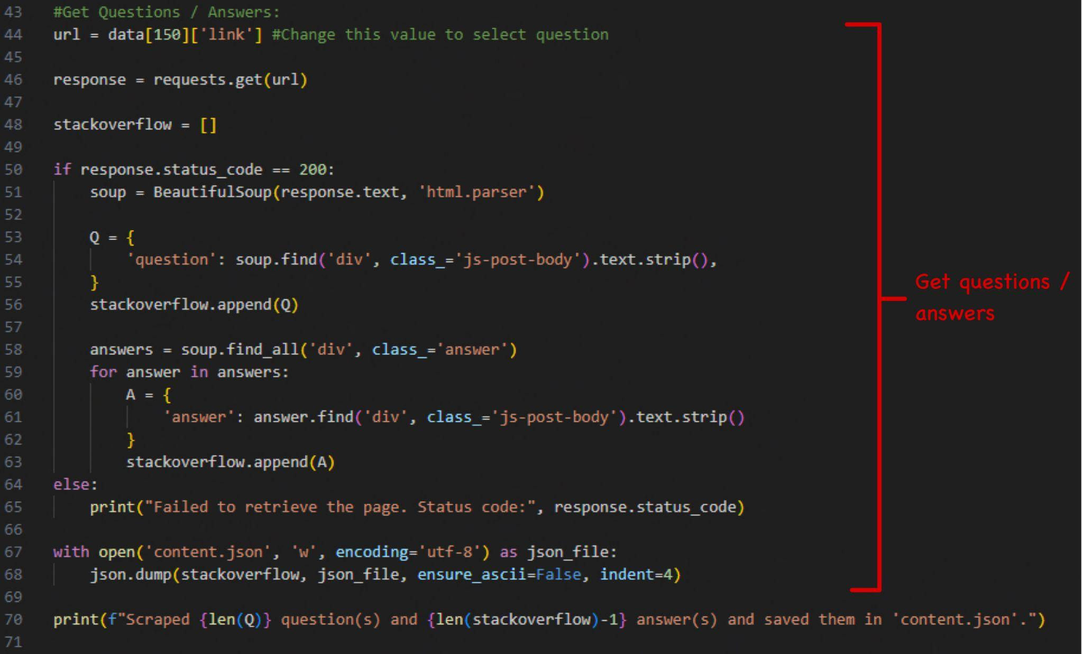
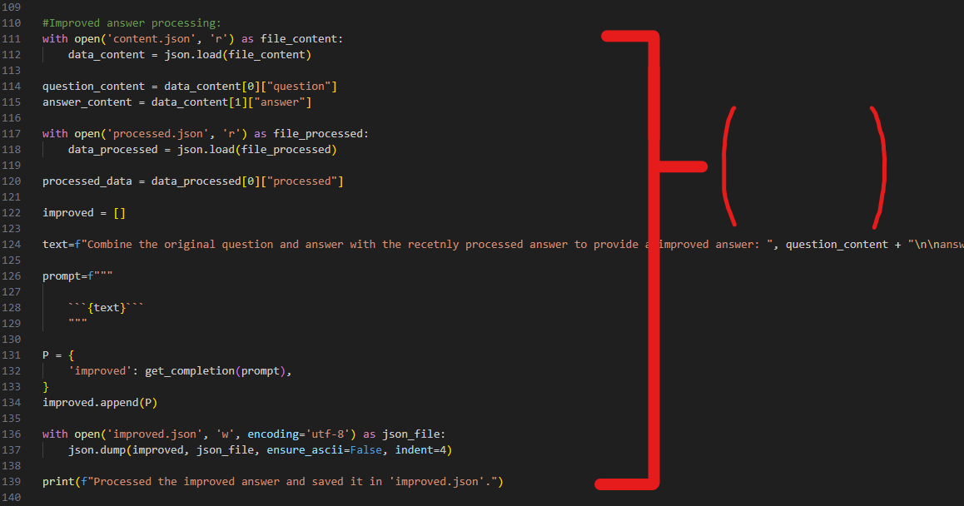
Some Code:
Processes
improved
answer and
outputs

Slide 5
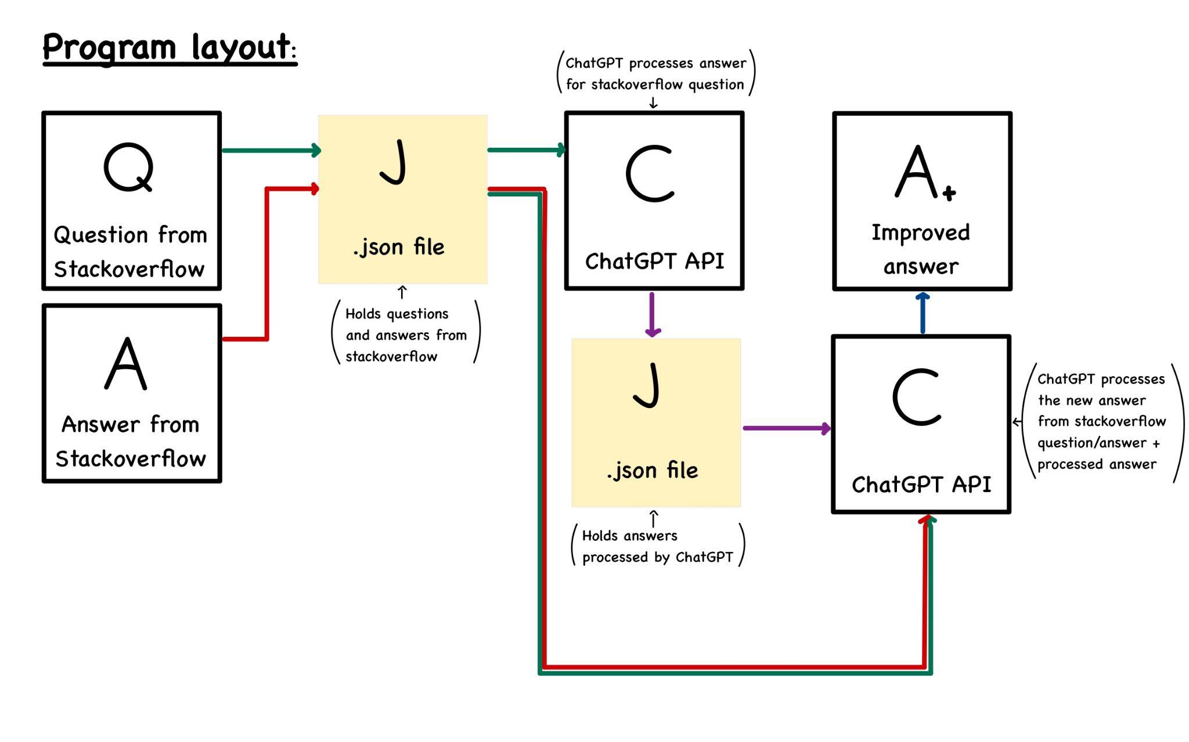

Slide 6
Examples:
Example 1:
Title:
“ModuleNotFoundError: No module named 'llama_index.langchain_helpers.chatgpt'“
Question:
“I'd like to use ChatGPTLLMPredictor from llama_index.langchain_helpers.chatgpt, but I got an error below on M1 Macbook Air:
‘ModuleNotFoundError: No module named 'llama_index.langchain_helpers.chatgpt'
My code looks like this and line 3 is the problem….”
Link: “https://stackoverflow.com/questions/76040306/modulenotfounderror-no-module-named-llama-index-langchain-helpers-chatgpt“
Prompt:
“How would you explain the following:”
2nd Prompt:
“Combine the original question and answer with the recetnly processed answer to provide a improved answer: ", question_content + "\n\nanswer: \n" + answer_content + "\n\nprocessed answer: \n" + processed_data”

Slide 7

Results:
Example 1:
Output:
Processed answer:
“It appears that you are trying to import the module 'ChatGPTLLMPredictor' from 'llama_index.langchain_helpers.chatgpt', but Python cannot find this module, hence the 'ModuleNotFoundError'. The error could be due to several reasons: 1. The 'llama_index.langchain_helpers.chatgpt' module does not exist in the 'llama_index' package. The package could have been updated, and the module might have been renamed, moved, or removed….”
Improved answer: “You are encountering a 'ModuleNotFoundError' when trying to import the 'ChatGPTLLMPredictor' from 'llama_index.langchain_helpers.chatgpt' on your M1 Macbook Air. This error can arise due to several reasons: 1. The 'llama_index.langchain_helpers.chatgpt' module may not exist in the 'llama_index' package. The package could have been updated, and the module might have been renamed, moved, or removed….“
Time to compute:
“~39.2 seconds”

Slide 8
Examples:
Example 2:
Title:
“How can I overcome ‘datetime.datetime not JSON serializable“
Question:
“I have a basic dict as follows….
When I try to do jsonify(sample) I get: ‘TypeError: datetime.datetime(2012, 8, 8, 21, 46, 24, 862000) is not JSON serializable’ What can I do such that my dictionary sample can overcome the error above?”
Link: “https://stackoverflow.com/questions/11875770/how-can-i-overcome-datetime-datetime-not-json-serializable“
Prompt:
“I need help with the following question:”
2nd Prompt:
“Can you combine these two answers and question to create an improved answer that expands on readability: ", question_content + "\n\nanswer: \n" + answer_content + "\n\nprocessed answer: \n" + processed_data”

Slide 9

Results:
Example 2:
Output:
Processed answer:
“The error message is explaining that JSON does not know how to serialize datetime.datetime objects. You will need to convert the datetime object to a string before passing it to jsonify. You can convert the datetime object to a string using strftime function. Here is an example:```python from datetime import datetime sample = {}\nsample['title'] = \"String\" somedatetimehere = datetime.now()\nsample['somedate'] = somedatetimehere.strftime(\"%Y-%m-%d %H:%M:%S.%f\") jsonify(sample) ``` In the above code, we are converting the datetime object to a string with the format \"YYYY-MM-DD HH:MM:SS.ssssss\...”
Improved answer: “The error message you're encountering is due to JSON's inability to serialize datetime.datetime objects. To overcome this issue, you need to convert the datetime object to a string before passing it to jsonify. This can be achieved using the strftime function. Here is an example: ```python from datetime import datetime sample = {} sample['title'] = \"String\" somedatetimehere = datetime.now() sample['somedate'] = somedatetimehere.strftime(\"%Y-%m-%d %H:%M:%S.%f\") jsonify(sample) ``` n the above code, we are converting the datetime object to a string with the format \"YYYY-MM-DD HH:MM:SS.ssssss\….“
Time to compute:
“~30.5 seconds”

Slide 10
Techniques:
Few-Shot Prompting (“allows a language model to adapt”)
By using multiple instances of the same LLM API, we can train our model by providing it more and more information. The more information that is provided, the more desirable the outcome will be. In this case, we train our model with 2 run throughs which trains it on the first pass and provides the improved answer on the second.
Prompt Programming / Natural Language Prompts (“crafting prompts that convey the desired task”)
When asking the program to generate an improved answer, it’s important to be concise and descriptive with the prompt. Such a prompt will improve the coherence-ness and clarity of user queries.
Chain of Thought and Chain of Reasoning (“a series of intermediate reasoning steps”)
A non structured query can confuse the model and provide an answer that is not the desired one. For example, it might not be able to get from point a to b and might instead go straight to f.
Easier Computation / Program decomposition (“breaking a complex problem or system into parts”)
Providing the model with the question, answer and processed answer will give it as much information as possible in order to ascertain the proper order of operations in order to compute the problem. The comparison of the two answers ensures that whatever parts were missed in the first run through and addressed in the second one.

Slide 11
Future / Challenges:
Questions with no answers
Since we are taking the 300 newest programming related questions, we will sometimes get questions with no answers, because no ones has had time to answer them yet. Therefore we need a way to only provide the processed answer or we can wait for a real person to answer it and go through our normal process.
Improved speed
We can further increase the processing time by cleaning up the code. Doing so would make the program more usable and efficient for the end user.
Accuracy
With so many programming questions being scrapped there's bound to be duplicates or questions that don’t make sense / aren’t relevant. We can implement a feature that uses machine learning to detect such questions and remove them from the list
Multiple answers
With some stack overflow questions, there are many answers that people provide, one of the examples we did at 30! Eventually we can combine these 3 answers with our improved answer to get a super accurate answer from a LLM API that's already been trained by processing the first two answers.

Slide 12
Conclusion:
Why is this relevant?
So we can improve quality of code and make learning easier.
How are we doing it?
By processing existing confusing answers into new descriptive and clear answers.
Why does it work?
Because a trained model is processing our answers and improving upon them.
Whats next?
Further improving the quality of answers and scaling to handle more answers.

Slide 13
Questions?
You can also email me any questions at: carnevap@uwindsor.ca

Slide 14
References:
Jiang, X., Dong, Y., Wang, L., Fang, Z., Shang, Q., Li, G., Jin, Z., & Jiao, W. (2023, August 3). Self-planning code generation with large language models. arXiv.org. https://arxiv.org/abs/2303.06689
Li, J., Li, G., Li, Y., & Jin, Z. (2023, September 7). Structured chain-of-thought prompting for code generation. arXiv.org. https://arxiv.org/abs/2305.06599
Tavakoli, N. (n.d.). Introducing “Lime” and “Shap” (as two great candidates to explain machine learning models). Windsor.
University, J. L. A., Leinonen, J., University, A., University, A. H. A., Hellas, A., University, S. S. A., Sarsa, S., University, B. R. A. C., Reeves, B., University, A. C., Paul Denny The University of Auckland, Denny, P., Auckland, T. U. of, University, J. P. A. C., Prather, J., Brett A. Becker University College Dublin, Becker, B. A., Dublin, U. C., University, N. K., … Metrics, O. M. A. (2023, March 1). Using large language models to enhance programming error messages: Proceedings of the 54th ACM technical symposium on computer science education v. 1. ACM Conferences. https://dl.acm.org/doi/abs/10.1145/3545945.3569770
Austin, J., Odena, A., Nye, M., Bosma, M., Michalewski, H., Dohan, D., Jiang, E., Cai, C., Terry, M., Le, Q., & Sutton, C. (2021, August 16). Program synthesis with large language models. arXiv.org. https://arxiv.org/abs/2108.07732

